Slide 1







Towards Sustainable Festival Travel: Data-Driven Insights GROUP MEMBERS: 1) ABHISHEK PRABHU 2) NISHANT DALVI 3) APURV GAIKWAD

Slide 2
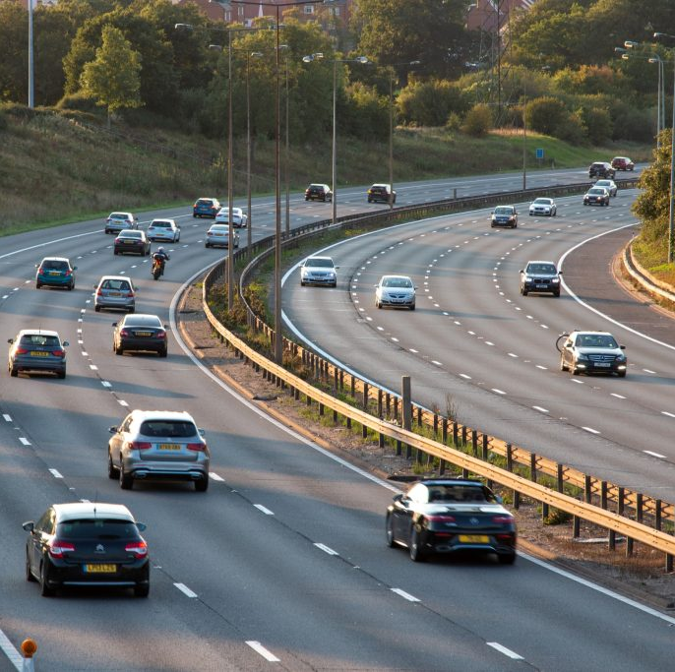
INTRODUCTION
The EcoSound Festival at Heaton Park, Manchester, is a major annual event attracting attendees from across the UK. However, the travel choices made by festival-goers contribute significantly to carbon emissions, posing a challenge to environmental sustainability.
This analysis aims to answer key questions such as:
1) What is the greenest way to travel to the festival?
2) How do traveler demographics, such as age, influence their travel choices?
3) What role does congestion and time of travel play in emissions?
By utilizing Power BI for data preprocessing and visualization, and R for predictive analysis, this study uncovers actionable insights to promote sustainable travel solutions and reduce carbon footprints.

Slide 3
Data Overview:
The Dataset used were as follows:
1) Master Dataset: Contains details about traveler journeys (e.g., mode of transport, age group, peak/no peak time).
2) Congestion Factor: i) Contains congestion factors for different travel modes during peak and no-peak times.
ii) Congestion factors based on weather conditions (e.g., Rain, Cloudy, Sunny).
iii) Congestion factors for specific days of the week
3) Eco-Consciousness, Emissions and Extra-cost
Data Challenges:
Duplicate Values: In the Mode of Transport column (e.g., in the Weather Table and Base Table).
Text Inconsistencies: "Peak" vs. "NoPeak" and inconsistent casing/spaces.
Null Values: Missing congestion factors or emissions data.
Relationship Conflicts: Errors due to one-to-many relationship enforcement in Power BI.
Impact of Challenges:
Data inconsistencies can lead to incorrect analysis results.
Relationship errors prevent proper merging of tables.

Slide 4
Data Cleaning and Processing Steps:
Mode of Transport (Origin):Rows with null values were removed due to minimal impact.
Carpooling Column: Null values were replaced with the median value of Carpooling based on the corresponding Mode of Transport.
Applied trim and lowercase transformations to remove inconsistencies in Mode of Transport and Peak/NoPeak columns.
Converted negative values in the Distance column to positive for data accuracy
Transformed categorical age ranges (e.g., 18-24) into numeric values to enable eco-consciousness scoring.
Merging Tables:
Performed Left Outer Joins to enrich the Master Dataset: i) Merged Base Table (Mode of Transport + Peak/NoPeak → Congestion Factor).
ii) Merged to add congestion factor based on Weather Table.
iii) Merged to add congestion factor based on day of the week.
iv) Included eco-consciousness by aligning numeric age group to age.
Data Validation:
Ensured table relationships were consistent using One-to-Many and Many-to-Many joins where needed.
Verified cleaned data for errors and formatting issues before visualization.

Slide 5
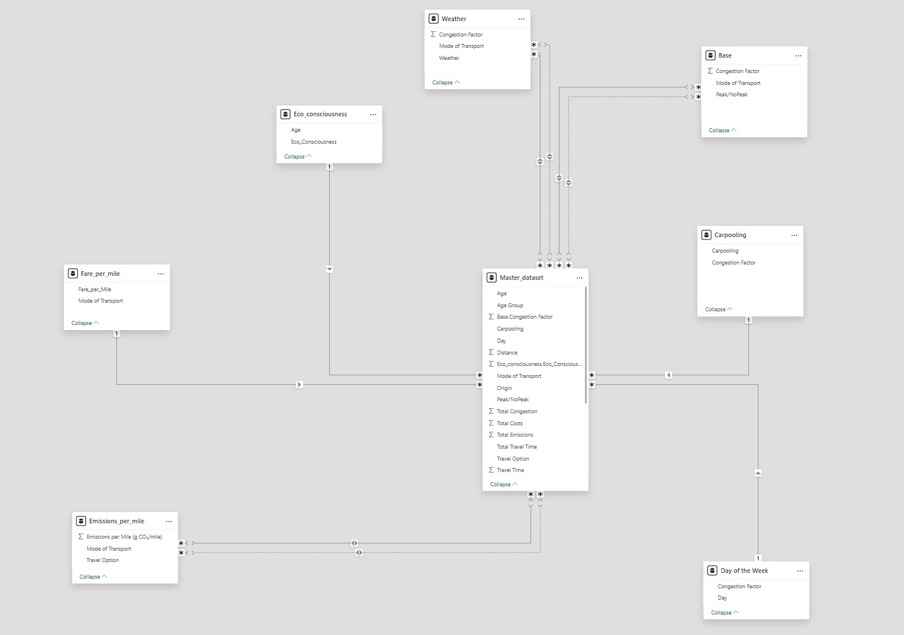
Added New Calculated columns: i) Total Emissions = Emissions per Mile x Distance Captures the total carbon footprint for each journey based on distance traveled ii) Total Costs = Fare per mile x Distance + Extra cost Calculates the total travel cost, including fares and additional expenses. iii) Total Congestion Factor = Mode of Transport Factor × Peak/ NoPeak Factor × Weather Factor × Day of Week Factor iv) Avg Congestion Factor = Dax measures were used to calculate this Relationship Built after combining the dataset and adding new column into the master dataset

Slide 6
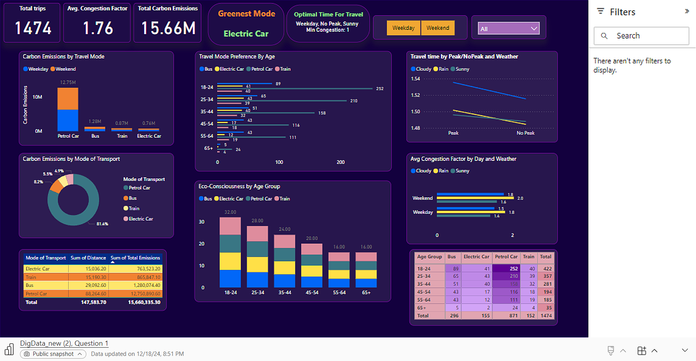
Question 1

Slide 7
Based on the visualizations provided: 1) How Do Different Travel Choices Affect the Carbon Footprint?
Petrol cars contribute 81.4% of carbon emissions, despite fewer trips than other modes.
Buses, trains, and electric cars have much lower emissions: i) Bus: 8.2% ii) Train: 5.5% iii) Electric car: 4.9%
Recommendation: Encourage festival-goers to choose electric cars, trains, or buses to reduce carbon footprints. Highlight the 12.75M kg of emissions from petrol cars and promote greener alternatives by ride-sharing or making use of cycle for short distances etc.
2) What is the greenest way and optimal time to travel to the festival at?
Greenest Mode: Electric Cars (4.9% of emissions, low carbon impact) and EV’s cover significant distances with minimal carbon footprint.
No-Peak hours during Weekdays and in Sunny weather show the lowest congestion (as seen in the "Travel Time by Peak/NoPeak and Weather" chart)
Recommendation:
Promote electric cars and partner with EV companies to install charging stations near the venue
Encourage travel during No-Peak hours and favorable weather conditions to reduce congestion and travel time.

Slide 8
3) How Can We Promote Sustainable Travel to Festival Goers? Offering Incentives: i) Provide discounted tickets or exclusive offers to those traveling via Trains, Buses, or Electric Cars. ii) Highlight the eco-conscious benefits of shared and sustainable travel. Educational Campaigns: i) Target younger age groups (e.g., 18-24 and 25-34), as they make the most trips and have higher eco-conscious scores. ii) Use visuals (like “You saved X tons of CO₂!”) to encourage public transport usage. Peak Travel Awareness: i) Promote travel during No-Peak hours, which show lower congestion (as per Travel Time by Peak/NoPeak and Weather chart). Weather-Specific Messaging: i) Highlight congestion reductions when traveling in Sunny conditions compared to Cloudy/Rainy.

Slide 9
4) Does Age of Travelers Affect Mode of Travel and Optimal Time to Travel to the Festival?
Age and Mode of Travel
18-24 and 25-34 age groups prefer Petrol Cars:
18-24: 252 trips (highest contribution to emissions).
25-34: High usage of Petrol Cars and Electric Cars.
Older travelers (45+) favor Buses and Trains for travel.
Key Point: Younger travelers are the main contributors to emissions.
Recommendation:
Target 18-34 age groups with incentives for using greener transport like Electric Cars, Buses, and Trains.
Promote awareness campaigns emphasizing carbon footprint reduction.
Age and Optimal Travel Time
No-Peak hours have lower congestion for all age groups.
Younger travelers (18-34) tend to travel during Peak hours, causing higher congestion.
Optimal Travel Conditions:
Weekdays + No-Peak hours + Sunny weather → Lowest congestion (Congestion Factor = 1).
Recommendation:
Encourage all age groups, especially younger travelers, to travel during Weekdays and No-Peak hours and favorable weather conditions.

Slide 10
Predictive analysis performed in R: Predicting Total Emissions Using XGBoost Objective: To predict Total Emissions accurately based on transport and related factors. Key Features Influencing Emissions:
Mode of Transport: Directly impacts emission levels.
Distance: Longer distances contribute to higher emissions.
Carpooling: Reduces emissions per person.
Log_Total.Emissions: Captures non-linearity in emission trends.

Slide 11
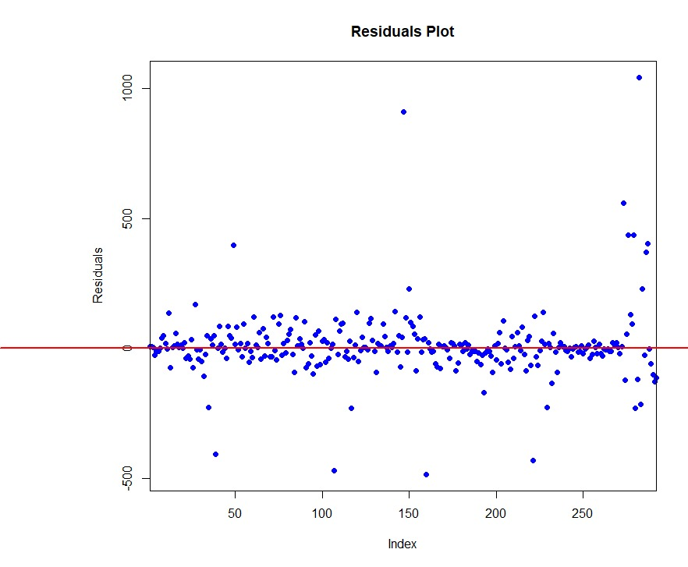
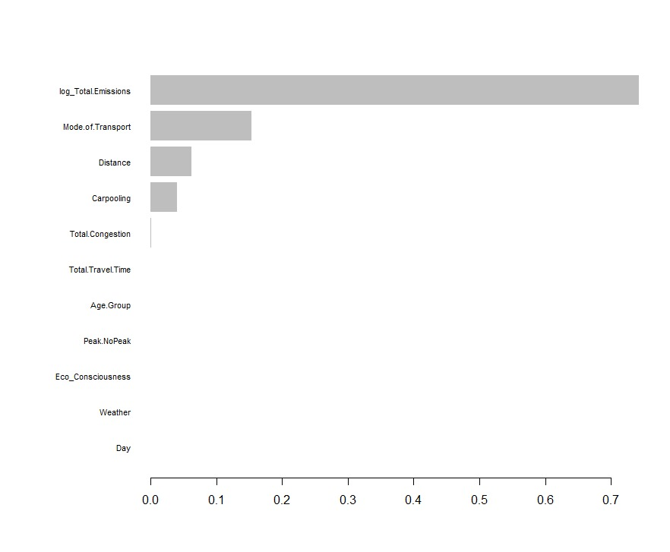
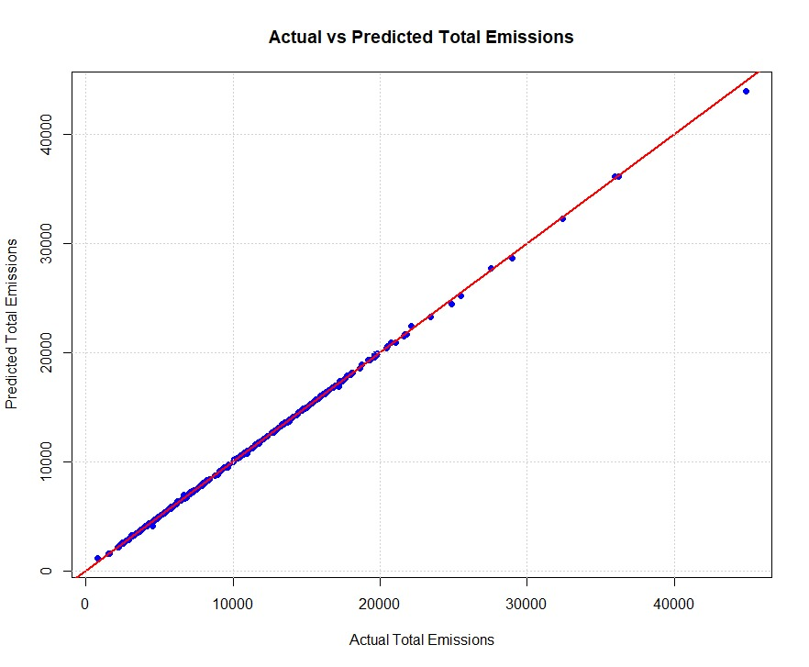

Slide 12
Results and Insights based on predictive analysis:
Performance Metrics:
1) R-squared: 0.9983 (Explains 99.83% of the variance in emissions).
2) Mean Absolute Error (MAE): 0.0081 (Log-transformed scale).
3) Root Mean Square Error (RMSE): 0.0279 (Log-transformed scale).
Graph Insights:
Actual vs Predicted Plot:
Data points align closely with the red diagonal line, showing near-perfect prediction accuracy.
Demonstrates the model’s ability to predict emissions reliably.
Residuals Plot:
Residuals are distributed randomly around zero, indicating no systematic bias.
Minimal large residuals confirm robust generalization.
Conclusion:
The XGBoost model is highly accurate in predicting total emissions.
Results validate the model's reliability for actionable insights, such as identifying emission hotspots or optimizing transport systems.

